Slide 1
Computer Graphics
EG678EX
Hardware Concepts
[Note: This presentation is a reference. For detailed study, students must read the text book]
Prepared By: Dipesh Gautam

Slide 2
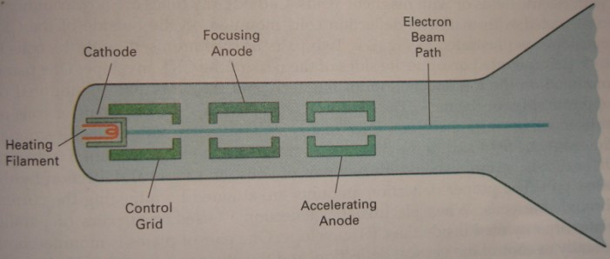
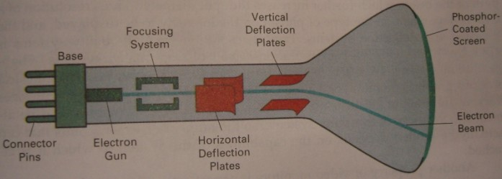
Video Display Devices
Cathode Ray Tube (CRT)
  Components:
    Electron Gun → composed of heated metal cathode and control grid
    Accelerating Anode
    Focusing System
    Deflection system
    Phosphor Screen
Prepared By: Dipesh Gautam

Slide 3
CRT Operation
Heat generated in cathode boils off the electrons
Electrons are accelerated towards phosphor screen with high positive voltage applied at accelerating anode
The negative voltage applied at cylindrical control grid controls the intensity of electron beam by repealing electrons
  High negative voltage stops electron passing from the hole of control grid while small negative voltage decreases electron passage
Focusing system concentrates electron beam to a small spot
  In electrostatic focusing, electrons pass through positively charged metal cylinder
  In magnetic focusing, coils are mounted outside of CRT Envelope which produces smallest spot
Deflection System deflects electron beam horizontally and vertically
  Magnetic→ two pairs of coils
  Electrostatic → two pairs of deflection plates
Refresh rate depends on persistence of phosphor
Prepared By: Dipesh Gautam

Slide 4
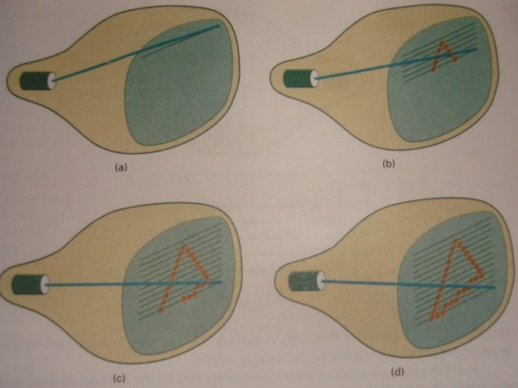
Raster Scan Displays
The electron beam is swept across the screen, one row at a time from top to bottom
The illuminated spot pattern is created by turning on or off when electron beam moves along each scan line
Picture definition is stored in a memory area called Refresh Buffer (Frame Buffer)
  Refresh Buffer holds the set of intensity values for all the screen points
  Each screen points is known as pixel (short form of picture element)
Example: Home television sets and printers
For bilevel system (black and white ) only 1 bit memory per pixel is sufficient
For color system more bits per pixel are needed
  For screen with resolution 1024 by 1024, and 24 bits per pixel (8 bits each for RGB) requires 3 MB of storage is needed
Refreshing rate for raster scan display is usually 60 to 80 frames per second (i.e 1/80 or 1/60 seconds is taken for electron beam to scan from top left corner to bottom right corner)
Prepared By: Dipesh Gautam

Slide 5
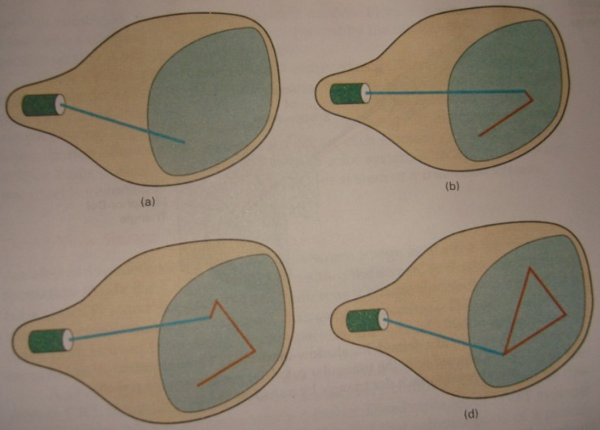
Random Scan Display
Electron beam is directed to the part of screen where picture is to be drawn
Picture definition is stored as set of line-drawing commands in memory are known as refresh display file or simply refresh buffer
Also known as Vector display
Prepared By: Dipesh Gautam

Slide 6
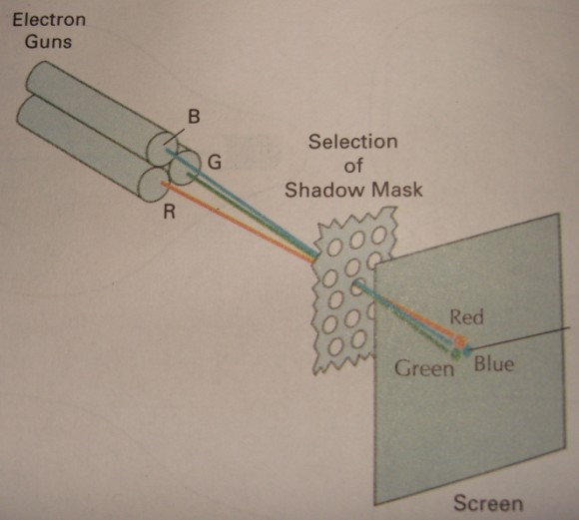
Color CRT Monitors
Uses combination of phosphors that emit different colored light (usually Red, Green and Blue)
Two basic methods for color picture display
  Beam penetration method
    Two layers of phosphor outer red layer and inner green layer
    slow electron strikes outer to produce red and faster strikes inner layer to produce green color while intermediate produces orange and yellow
    Only four colors are possible
  Shadow mask method
    Has three phosphor color dots (RGB) for each pixel position
    Three electron guns one for each color dot
    A shadow mask grid with holes aligned with the phosphor dot patterns
    Electron beams passed from a hole of shadow mask activate the phosphor dot pattern to display color picture
Prepared By: Dipesh Gautam

Slide 7
Flat Panel Displays
Emissive → converts electrical energy to light
  Eg: plasma panels, thin-film electroluminescent display, LEDs
Non Emissive→ uses optical effects to convert sunlight or light from other source into graphics pattern
  Eg: Liquid Crystal Display (LCD)
Prepared By: Dipesh Gautam

Slide 8
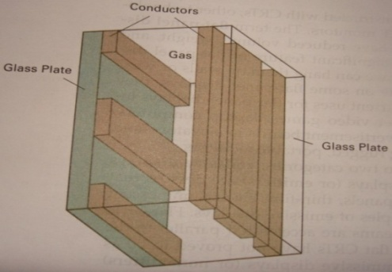
Plasma Panel (gas discharge display)
  The region between two glass plates are filled with a mixture of gases (usually includes neon)
  Series of vertical conducting ribbon is placed on one plate and horizontal on the other
  When firing voltage is applied between one horizontal and vertical conductor, the gas at intersection breaks up into glowing plasma ion and electrons
  Refresh is needed
  Monochromatic device; but now are capable of displaying color and grayscale
Thin Film electroluminescent Display
  Similar to plasma panel, but the space between glass plates is filled with phosphor, such as zinc sulfide doped with manganese
  When electricity is passed through two electrodes, the phosphor become the conductor in that area and the electrical energy is absorbed by manganese atom to release the energy as a spot of light
  Good color and grayscale are hard to achieve
Light Emitting Diode (LED)
  Diode matrix is arranged to form pixel position
  Various voltage level produces various color lights
Prepared By: Dipesh Gautam

Slide 9
Liquid Crystal Display (LCD)
  Uses liquid having crystalline arrangement of molecules
  The liquid crystal compounds keep the long axes of the rod shaped molecules aligned
  Two glass plates each containing light polarizer at right angles to other plate are placed to sandwich the liquid crystal
  Horizontal conductors in one and vertical in other plate are placed thus intersection forms a pixel
  When no voltage is applied between conductors, the molecules are in on state so the polarized light is twisted by the molecule thus passes through the two plates and seen by the viewer
  When voltage is applied, the molecules are in off state, and light passing through one plate is stopped at other thus no light is seen by viewer
  passive matrix: voltage is applied to intersecting conductor to turn off the pixel
  Active matrix: uses transistor to control voltage at pixel locations
  Color display is possible by using different materials or dyes and by placing a triad of color pixels at each screen location
Prepared By: Dipesh Gautam

Slide 10
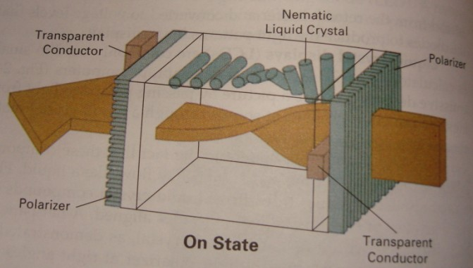
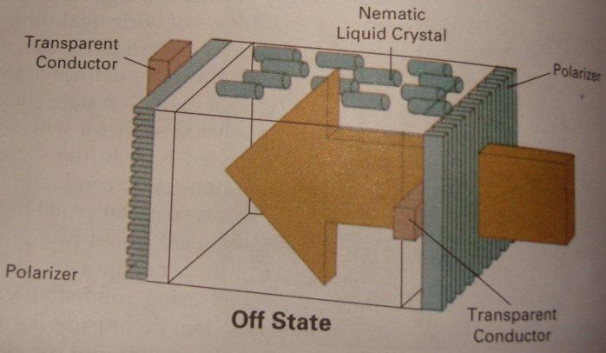
LCD
Prepared By: Dipesh Gautam

Slide 11
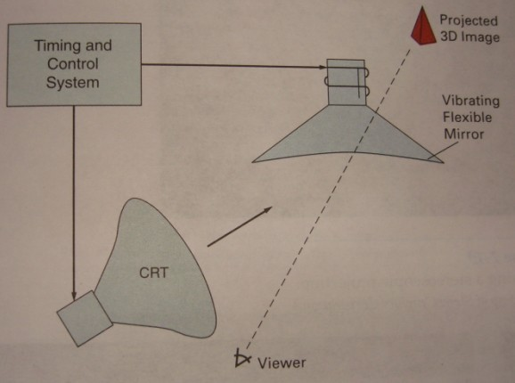
3D viewing Devices
  Displays 3-D scene
  Displayed by reflects CRT image from a vibrating mirror
  As mirror vibrates it changes focal length
  The vibration is synchronized with the display of an object on CRT so that each point in object is reflected from the mirror into a spatial position corresponding to distance of that point from a specified viewing position
Stereoscopic and Virtual Reality Systems
  READ YOURSELF
Prepared By: Dipesh Gautam

Slide 12
Input Devices
Keyboards
  ASCII keys are used to input text string
  Provides with features to facilitate entry of screen coordinates, menu selections or graphics functions
  Function keys allow user to enter frequently used operations in a single stroke and cursor cont keys are used for cursor position or picture selection
  Some keyboards consist of trackball or joystick
Mouse
  Pointing device to position cursor
  Wheel or rollers are used to record the amount and direction of movement
  Optical mouse uses optical sensors to detect mouse motion
  One two or three buttons are included
  [Note: For operation detail, please refer to internet sites such as wikipedia]
Trackball and Spaceball
Joysticks
Data Globe
Digitizers
Image Scanners
Touch Panels
Light Pens
Prepared By: Dipesh Gautam

Slide 13
Hard Copy Devices
Printers
  Character Impact (Dot matrix) printers
    Similar to raster scan system
    Prints one character at a time and scans one line at a time while for next line paper is scrolled
  Non impact
    Laser printers, ink jet, bubble jet
    In laser printers, laser beam creates a charge distribution on a rotating drum coated with a photoelectric materials such as selenium an tonner is applied to the drum and then transferred to paper
    In ink jet printer, the ink is squirted in horizontal rows across a roll of paper. The electrically charged ink stream is deflected by an electric field to produce to matrix patterns
    In bubble jet printers, ink is heated in a heating chamber to produce ink bubble. The heating chamber consists of heating filament
Prepared By: Dipesh Gautam

